Slide 1
Notes:
In the chat, let us know your role and where you are joining us from.
Welcome everyone to our last content area spotlight session of the day
where our focus will be…

Slide 2
new teachers
Notes:
In this session we are turning the spotlight on new teacher induction
supporting our newest teachers, our mentors and
really thinking about how we as leaders of this vital work can plan for this support for the 24-25 school year.

Slide 3
Keli Soliz
keli@lead4ward.com
@keli_soliz
Stephanie Zelenak
stephanie@lead4ward.com
@stephanieLCZ
Notes:
My name is Keli Soliz and I am joined today by my amazing colleague, Stephanie. Steph, would you like to say hello to everyone?

Slide 4
Notes:
Supporting new teachers, ITS WHAT WE DO!
You all know that as we think about the current climate in education…we have to acknowledge that NOW more than ever, we need a solid plan for:
supporting and growing our new-to-profession teachers
while simultaneously planning for ways to build the capacity of our mentors, of campus leaders, and of our district systems and leadership
Supporting new teachers, ITS WHAT WE DO!
link: planning with lead4ward for the 2024-25 school year – lead4ward
Like our other sessions, you will find these slides along with a helpful planning document on the link that Stephanie shared in the chat.
--
As you get acclimated to this planning document, let’s take a look at each section or column…

Slide 5
looking back | leading4ward
navigating the noise
launching the year
nurturing the new
getting in the groove
taking care of business
Notes:
for It’s – we’ll focus on what aspects of planning we will need to consider when we think about new teacher support…
looking back | leading4ward
navigating the noise
launching the year
nurturing the new
getting in the groove
taking care of business
now for what…

Slide 6
This Photo by Unknown Author is licensed under CC BY
Notes:
now for what….
We’ve provided some thought-provoking questions to help you to start thinking about important aspects and in this session, we’ll think about them through the lens of new teacher support and induction.

Slide 7
leaders
mentors
new teachers
Notes:
When I think of the “we” portion of this phrase, I think of the stakeholders. Who do we need to be a part of this work,
who will be taking action, or participating in our decision making or experiencing the outcomes of our decisions.
For our work with new teachers, there are three key players…
leaders – both district and campus, and we recognize that this may not always be a specific title, but more of a need that you are stepping up to lead. When we say leaders, we mean anyone working to prioritize new teacher support.
Then we have mentors who are chosen for effective instruction, classroom management, and great classroom engagement but also,
and maybe more importantly, those who WANT to mentor, who have a heart for growing others, who have the bandwidth to dedicate time and brainpower to supporting someone who is learning it all.
and of course, we have our new teachers - who we want to grow, we want to support, we want to retain…because all of that ultimately means our students are winning too!

Slide 8
Notes:
Lastly, is the do column….these are ideas to get you started…things you can do…items you can act on to intentionally support your newest teachers as they enter the profession of education.
This Photo by Unknown Author is licensed under CC BY-SA

Slide 9
new teachers
Notes:
because supporting new teachers…

Slide 10
Notes:
its what we do

Slide 11
how do you typically approach this time of year?
anticipation
survival
reflection
rejuvenation
disillusionment
Notes:
As we get started, I’d love to take a pulse check to see
--
how you are feeling about this time of year and maybe more specifically how you usually approach this time of year when planning for next year – all while tying up so many pieces of this year.
--
We’re going to use this chart to help us identify how we typically approach this time of year…or how you are feeling as you think about planning for the 24-25 school year.
--
are you in a state of anticipation? You’re excited, ready to go, eager to get started?
--
or are you in survival…so much coming at you and so much to do? You’re just making it through
--
or do you find yourself in disillusionment…unsure how you will get it all done, wondering why you agreed to this responsibility.
--
You might be feeling rejuvenated…you feel rested from spring break or excited about the work ahead.
--
or lastly are you in reflection…you’re really thinking about what has worked and what needs to change…
--
Will you please pick the word that best describes how you are approaching this time of year and share it in the chat with us…
share responses…
thank you for sharing where you currently are…
hopefully as we go along today, you will find opportunities to shift your thinking to one or more of the more positive descriptions.
I started with this because it helps us ground ourselves in the content, but also sets a bit of context as we think about our focus - supporting new teachers.

Slide 12
how do new teachers feel throughout the year?
anticipation
from Ellen Moir’s work at UCSC
anticipation
survival
reflection
rejuvenation
disillusionment
Notes:
Ellen Moir’s research provides us with helpful information to keep in mind as we plan for new teacher induction.
--
These are the phases of the new teacher
You’ll notice the months along the bottom of the chart and the graph showing the attitude and phase new teachers typically are in during each month of the year.
-- -- -- -- -- -- -- --
This research is critical to making sure what we plan for our new teachers is JUST IN TIME.
Thoughtful timing can help us to better meet new teacher needs and proactively provide support and encouragement as they go along.
Planning for new teacher induction with these phases in mind would be beneficial to everyone.
For example, the anticipation phase is a great time to set expectations for classroom procedures and management and start to lightly acclimate to the instructional resources available.
But when our new teachers are in disillusionment, we probably don’t want to introduce data meetings or have a book study. There brains are too overwhelmed to engage in those types of tasks.
So, keep these in mind as we talk through ideas today. and as you make plans for the 24-25 school year

Slide 13
looking back
leading4ward
accountability
changes in assessment
writing/reading
new staff
Notes:
let’s think together about looking back (being reflective)
and leading 4ward (anticipation)
New teachers will be hearing about STAAR, Accountability, the balance of writing and reading and more!
So, we must find ways to support our new staff through all this new learning.

Slide 14
looking back
leading4ward
build common language and understanding through common experiences
help new teachers to prioritize, pace and chunk their new learning to minimize stress
Notes:
We encourage you to consider how you will …
Help new teachers (and all teachers) experience shared learning about assessment, accountability and the writing/reading tango so that we cultivate a common language that is easy to understand and makes common conversations possible?
How will you help new teachers to prioritize what is most important at this moment…
---We all know the firehose feeling of too much information at once, so how can you be intentional about what information they receive, and when they receive it…
keeping in mind those phases we talked about.
Helping build capacity to prioritize these important topics is essential, and then….
we all have to trust the process, knowing that over time, our new teachers will get there!

Slide 15
looking back
leading4ward
induction program
first-year teacher academy
mentor and coaching academy
Notes:
in addition to those actions, we are here to support you as well.
Our first-year teacher academy is based on the phases of a new teachers and we are often invited into districts and campuses to faciilitate those ongoing, just in time professional learning opportunities for your new teachers throughout the year
Similarly, our mentoring training is designed for your mentors and leaders to receive support and build their leadership capacity so they can best navigate and support their mentees in their first or second year.
These can be tailored to the needs of your specific teachers and district.

Slide 16
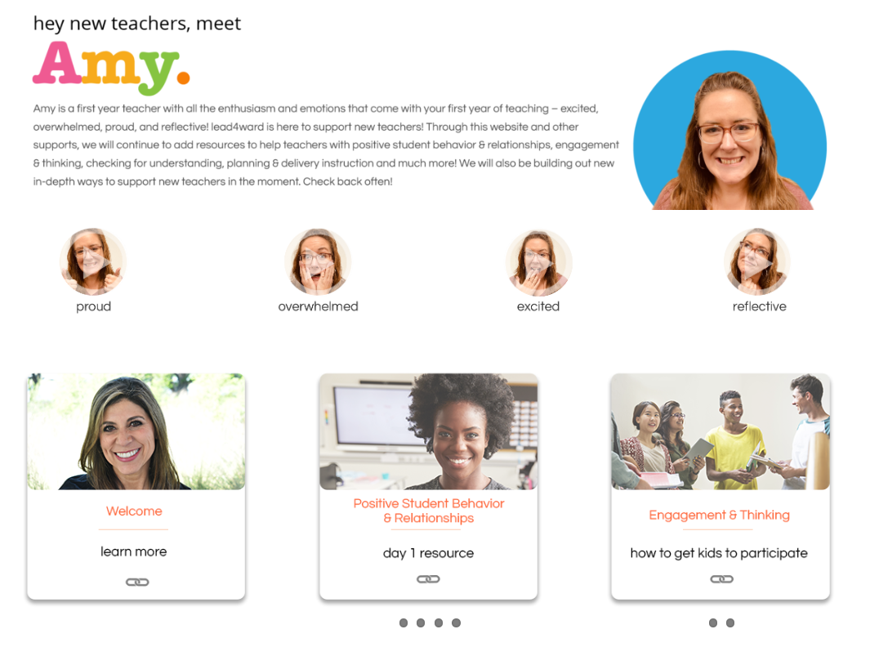
looking back
leading4ward
resources
new teacher site
first-year teacher notebook
mentoring and coaching notebook
Notes:
new teacher site: https://lead4ward.com/new-teacher/
Stephanie was the brains behind our awesome New teacher website.
***Steph, can you share a little about this goldmine?
Our new teacher website highlights new teacher around Texas as they share an ideas or strategy that works for them.
They can also pick a feeling to hear a word of encouragement or connection.
There are also great tools for important new teacher topics like:
positive student behavior and relationship building
engagement and thinking
and navigating demands and stress.
This site is a goldmine for new teachers
Like the website, our first year teacher notebook and the mentoring and coaching notebook go hand in hand acting as companion resources and providing just in time learning and support, chunked and timed based on when folks need it and are capable of receiving it best. .
You can find these books in our store, if you are interested.
Teacher Induction – lead4ward

Slide 17
navigating the noise
how will we maximize the use of assessments?
how will accountability ratings impact our focus on student learning?
everything is new to a new teacher!
Notes:
Now, let’s talk about navigating the noise….
As we think about this one, it’s important to ask ourselves…
What makes sense to do as it relates to assessment and accountability for new teachers!
These are complex and advanced topics in the scope of teaching….and
*******We have to remember that this is all new learning for our early career teachers…not a revisit or a refresh!
We encourage you to think about
what you want to prioritize?
How you will support new teachers in learning it all?
Where you want them to start?

Slide 18
navigating the noise
identify who will take the responsibility
develop a plan for gradual release of responsibility
everything is new to a new teacher!
Notes:
When navigating the noise, the gradual release model might be a helpful approach –
think…
--
who can model what we want new teachers to eventually be able to do on their own, in regard to assessments and student learning,
what aspects are they ready to take on as they go…what’s best for their first year… how have we prepared them to take on the responsibility in year 2 or year 3?
What a gift ….
if you can relieve the weight of some of these components for new teachers – and in year 1, identify who can offer support, model, and guide your new teachers?
and then
what is your plan for developing them to be ready to take this on in year 2 or 3?
--
remember…everything is new to a new teacher…and they will experience new throughout each phase they enter….

Slide 19
navigating the noise
how will state adopted or district selected instructional resources impact our instructional program?
everything is new to a new teacher!
Notes:
another ‘what’ we need to be mindful of with supporting our new teachers is
how will state adopted or district selected instructional resources impact our instructional program?
You all know that these resources have a direct impact on the teaching and learning in the classroom.
As you plan to help your new teachers navigate the noise of ALL NEW resources…
remember
--
everything is new to them, so how will you support them and pace out the learning?
Will you introduce frequently used practices first?
Will you work to find aligned practices across content areas for those who teach in self-contained classrooms, so their instruction can flow while they learn the content along the way?

Slide 20
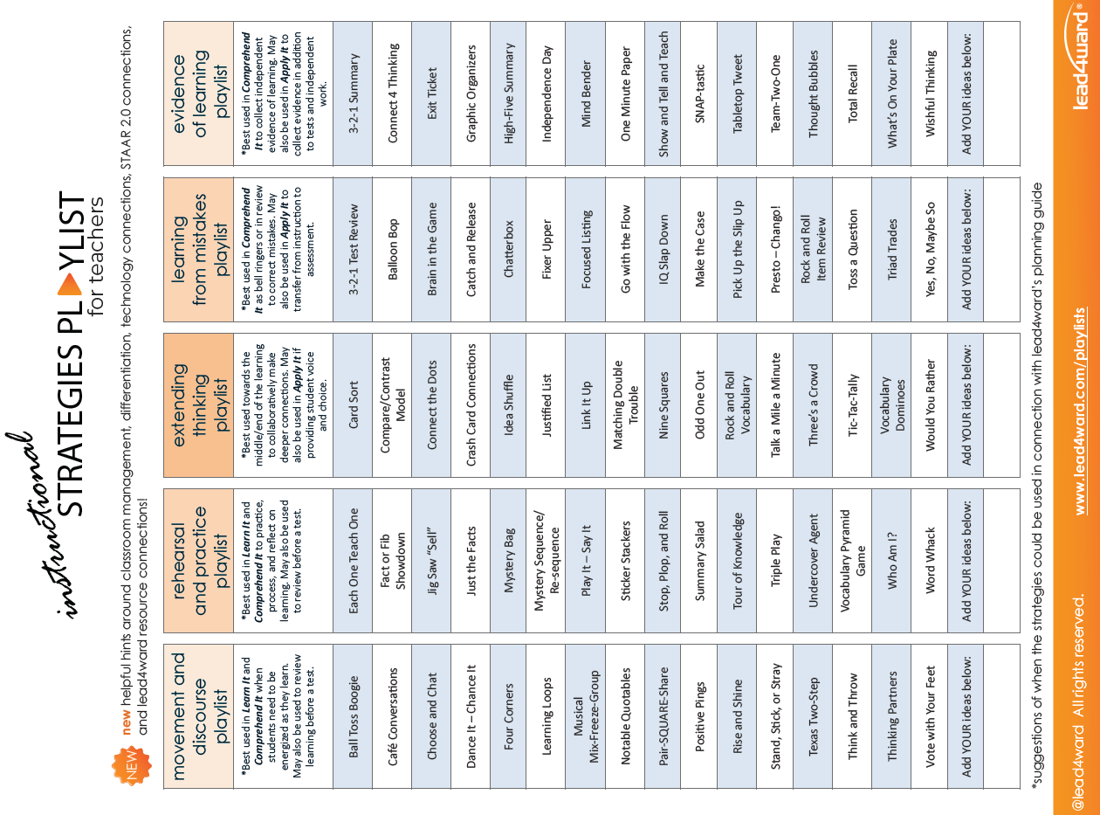
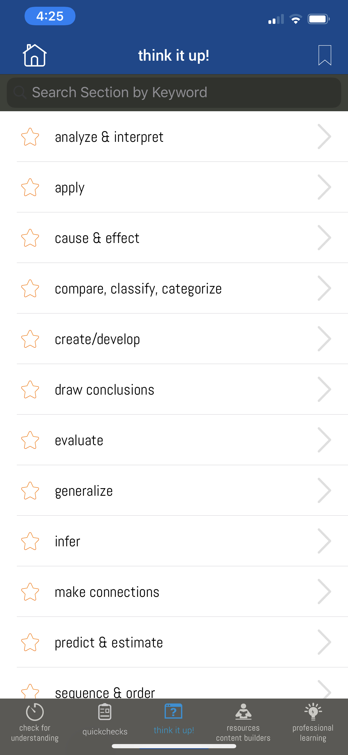
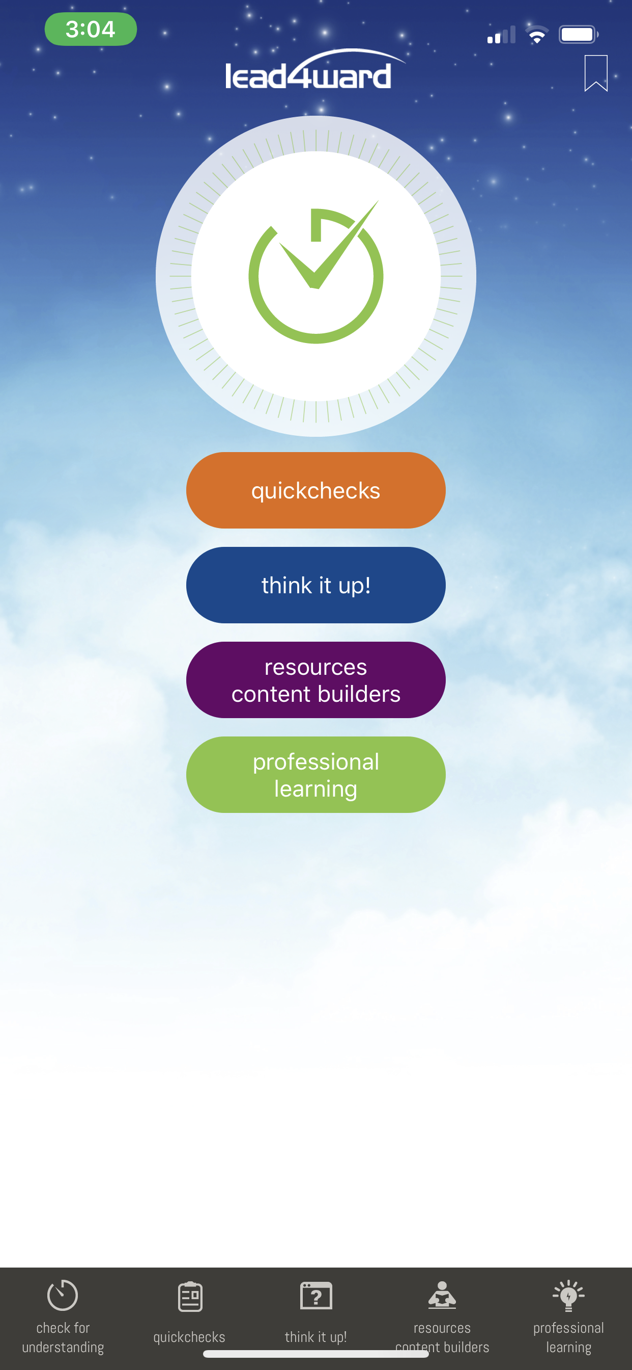
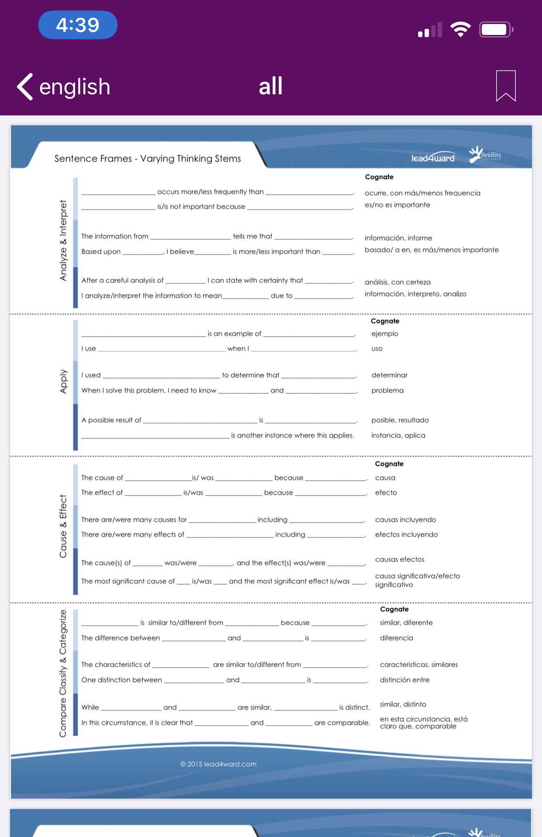
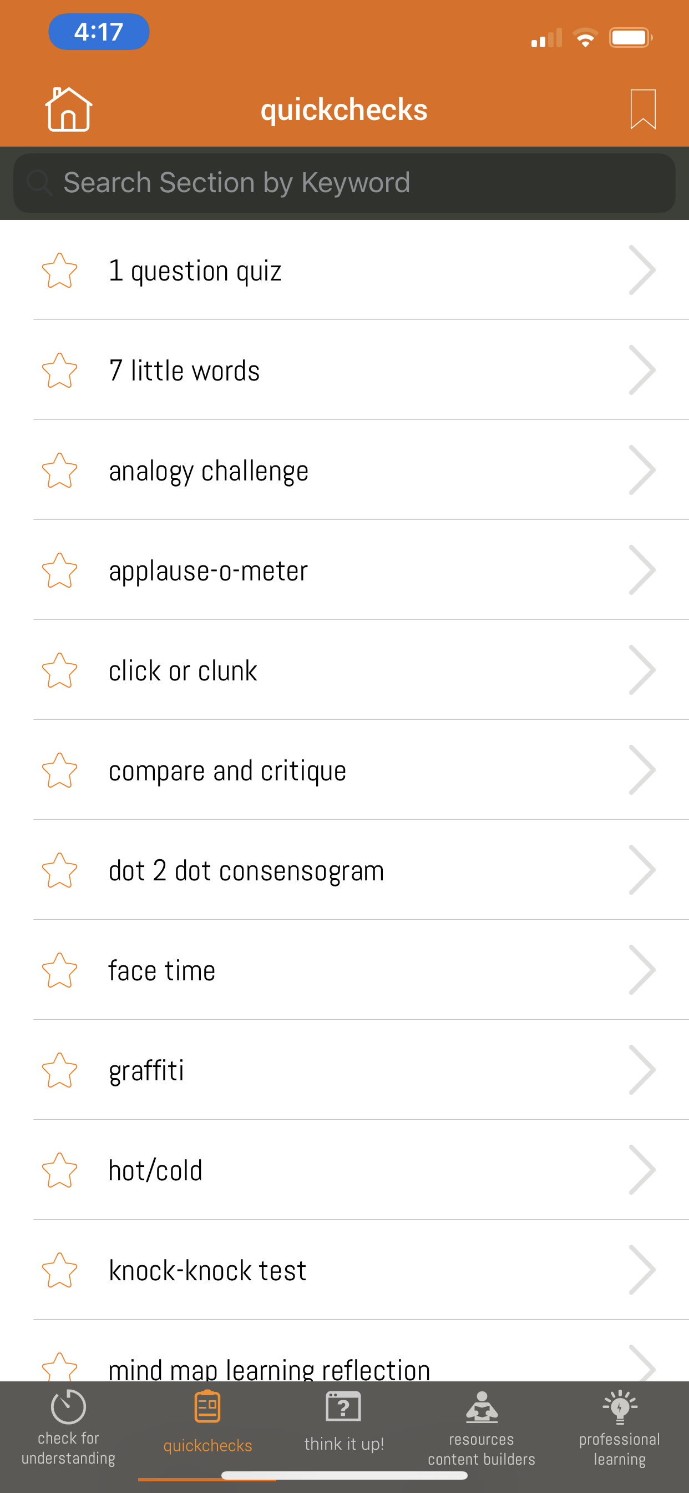
navigating the noise
access and support around the resources that are available
instructional strategies playlist
think it up! & thinking stems
quickchecks
Notes:
link to resources and instructional tools: https://lead4ward.com/resources/
As new teachers begin to have a handle on their classroom management systems and learn to prioritize the many to-dos in relation to time, space, materials, and behavior,
they will need access and support to make the most of what they have. Time to try, feedback, opportunities to learn and see it in action so they build their self-efficacy.
Our instructional tools may serve some of these needs for your teachers as well.
We always encourage mentors and those providing learning for new teachers to
provide just in time,
actionable and
easy to implement strategies
that allow our newest teachers to check for understanding + engage learners + allow for processing time + and assess their students’ learning throughout a lesson, unit, or concept.
This is essential to new teacher success and will take them from survival and disillusionment to rejuvenation and reflection more smoothly!
So, be sure to take advantage of these resources
--
The Instructional Strategies playlist
--
Think it up &
--
thinkings stems
--
and quickchecks.
Such powerful tools that make teaching and learning more attainable for all teachers
as we reflect and anticipate how we will help new teachers to navigate the noise, this is a good time to pause to process. Stephanie, can you help us do that, please?

Slide 21
looking back
leading4ward
navigating the noise
What stands out to you?
What do you want to remember?
Notes:
***SZ
--
we’ve looked back and thought about leading 4ward
--
and we’ve shared ideas to help navigate the noise
So, let’s pause to check in…
--
what stands out to you as you plan for new teachers with these in mind?
What do you want to remember from our brief discussion?
Unmute or chat

Slide 22
launching the year
how do we ensure a good start to the new year?
Notes:
As we plan for launching the year
how do you plan to ensure a good start?

Slide 23
launching the year
set the tone
first-year teacher notebook
pages 28 - 31
inspire hope
Notes:
Welcoming your new teachers from day one is a huge MUST!
The research about our Gen Z teaching population says that they
tend to decide during their first day and first week on the job whether or not they will stay on the job for the long term.
The first day and first week on the job have never been more important.
--
That’s why it takes leaders at both the district and the campus in combination with mentors to create a culture that inspires hope and makes new teachers feel welcome!
this is a good time to think about how you can assign intentional mentors - who is willing to support!
--
We want mentors and leaders to inspire hope not feed the fear!
--
We have to ask ourselves when and how we will support new teachers and mentors from the beginning… remember we want to start strong and set the tone for a wonderful school year.
-
in the first-year teacher notebook on pages 28-31

Slide 24
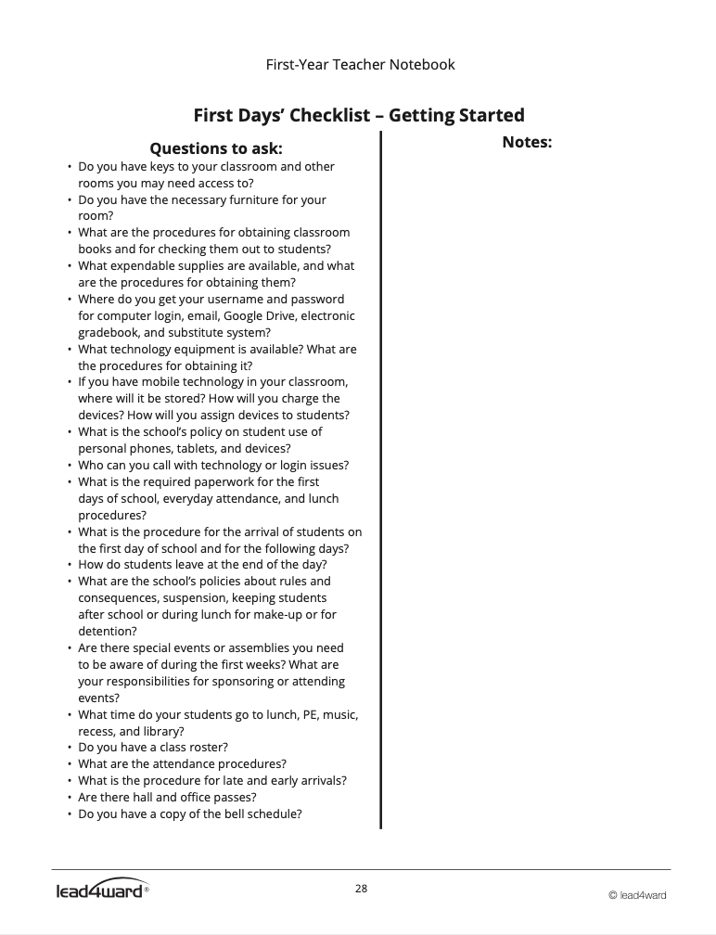
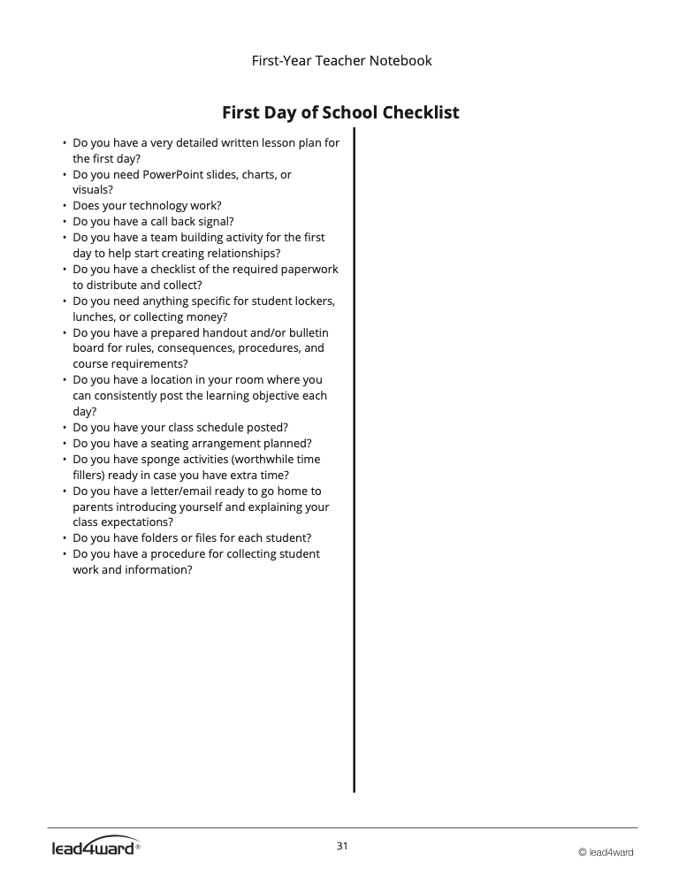
launching the year
first days’ checklist: getting started
first day of school checklist
Notes:
we have extensive checklists that are supportive resources that help to make sure new teachers are ready for
---the first days on the job and
-the vey first day of school with students
These are so helpful in answering the questions that new teachers typically have and they assist leaders and mentors in planing ahead to be sure supports are in place and answers are ready for these common new teacher needs.

Slide 25
nurturing the new
how do we support new leaders and new teachers?
Notes:
The next piece is nurturing the new…
how do we support our new teachers (in this case)?

Slide 26
nurturing the new
prioritize focus areas in logical & learnable chunks
first-year teacher academy
mentor teacher academy
provide ongoing professional development for mentor & new to profession teacher program
Notes:
You might have noticed that prioritizing information and tasks is a really hard thing for new teachers to do.
It ALL feel urgent and important. So as leaders, you can plan and prioritize focus areas in a logical and learnable chunks.
What comes first and when? and then what’s next?, etc.
We have done a lot of that research and thinking as it relates to the phases of new teachers and the first-year teacher academy and mentor academy are designed in a logical and comprehensible fashion and we would love to partner with you in bringing that to your new teachers and mentors.
This would also align with the second bullet which reminds us that we have to build in time for ongoing professional learning for all of our stakeholders.

Slide 27
nurturing the new
prioritize focus areas in logical & learnable chunks
first-year teacher academy
mentor teacher academy
provide ongoing professional development for mentor/new to profession teacher program
Notes:
Our mentoring ePLC, which many of you on the call participate in, are virtual, just in time sessions for mentors. Throughout the year, we offer some pre-recorded and some virtual live one-hour session to help mentors understand the current phase of their new teacher and to best support them throughout the year.
That link is in the chat if your district is interested in joining the many other districts in this learning.

Slide 28
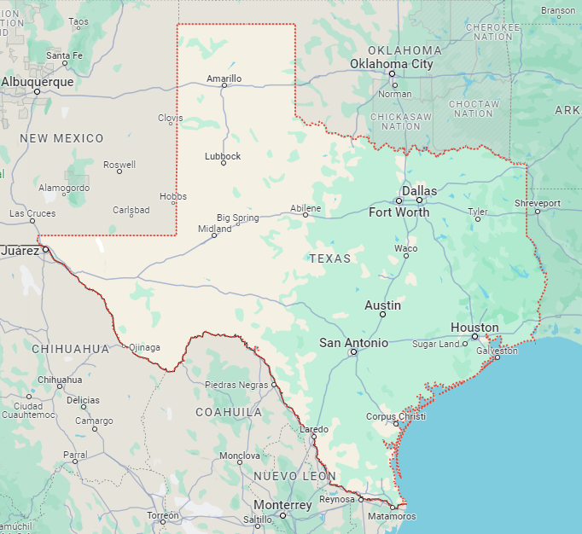
teacher induction TOT
upcoming dates and locations
Houston area
Cypress-Fairbanks ISD
April 30th, May 1st, May 2nd
Register Now
West Texas area
Ysleta ISD, El Paso
May 29th, 30th, 31st
Registration coming soon
Dallas area
Garland ISD
May 20th, May 21st, May 22nd
Register Now
Central Texas area
Luling ISD
Early June
Registration coming soon
https://lead4ward.com/open-sessions
new to profession
Notes:
We also recognize that some district have the personnel to provide this type of ongoing learning for new teachers and their mentors. For this we offer our Teacher Induction Training-of-Trainers.
We’ve got sessions scheduled in the
--Houston area,
--
Dallas area
--
West Texas, El Paso area and
--
have an upcoming opportunity in the central Texas area
These in person 3 day TOT sessions give your district induction trainers the resources and tools they need to offer their own First year Teacher academy and mentor academy. .
We include slides, both of the companion books, training tips, and experiences to take back. It’s all there!
If you’re interested joining one of the upcoming sessions, be sure to register soon, as the dates are approaching and space is limited.
https://lead4ward.com/open-sessions/#tab-fbc3df5666ec60dafea
So, I have to confess that I’ve been keeping an important piece of Ellen Moir’s new teacher research from you…Stephanie, can you tell them about what the research tells happens when new teachers have mentor support?

Slide 29
how do new teacher feel throughout the year?
anticipation
from Ellen Moir’s work at UCSC
anticipation
survival
reflection
rejuvenation
disillusionment
Mentoring & Coaching Notebook page 53
Notes:
SZ
remember this graph…
well there’s more to it…

Slide 30
how do new teacher feel throughout the year?
anticipation
from Ellen Moir’s work at UCSC
anticipation
survival
reflection
rejuvenation
disillusionment
Mentoring & Coaching Notebook page 53
Notes:
SZ
the research shows that teachers who received support from a mentor had a smoother year and felt less extreme disillusionment and more of a steady rise after mid-year.
You guys…Support matters and the research tells us that the support has to be ongoing for at least 2 years or longer to have the greatest impact on teacher retention and student success.
as leaders, you set the tone of this support…
so you might consider.

Slide 31
nurturing the new
develop a calendar for induction and mentoring support
commit to simplicity
help your new teachers focus on what is most important
Notes:
Knowing the impact of mentors on our new teachers…we have some things we recommend considering…
---
protect time on the calendar for your new teachers
--
simplify their meetings to the essentials
--
considering what they need when they need it to help your new teachers focus on what is most important

Slide 32
getting in the groove
what routines and processes do we put in place?
Notes:
Alright…let’s get in the groove…
What routines and processes might you put in place?

Slide 33
how do new teacher feel throughout the year?
from Ellen Moir’s work at UCSC
anticipation
anticipation
survival
reflection
rejuvenation
disillusionment
Mentoring & Coaching Notebook page 53
Notes:
Let’s Loop back to phases
Remember that everyone might not be at the same place…
----
the month scale may shift, depending on our new teachers’ start date
Be on the lookout for your late hires and how you are prioritizing the same welcome and support no matter when they start
How do you capture what happens at your new teacher orientation so that any new hire has a similar opportunity?

Slide 34
getting in the groove
revisit
prioritize
simplify
focus
routines
leaders
mentors
new teachers
Notes:
we get in this groove by
revisiting, prioritizing, simplifying, and focusing
--
our routines
And this includes our leaders at both the
district
campus
Our
mentors and
new to profession teachers

Slide 35
taking care of
business
how will we use our funding resources to maximize student learning?
Notes:
let’s take care of business
The question is often….how will we use our funding resources to maximize student learning?
and in our instance make sure our new teachers are supported, elevated and retained so that we maximize student learning?

Slide 36
taking care of
business
evaluate funding sources
remaining ESSER III funds
Title II
prioritize support
Notes:
To truly prioritize new teacher induction, it may take resources like books or professional learning or resources like time – you may want sub coverage for new teachers to observe mentors…or you might consider offering Stipends for mentors.
for these reasons,
Being informed of the sources of funding that can be used to support new teacher induction and mentors, is essential…
--
if you have remaining ESSER III funds for services like professional development
, you might be able to use those and look into the opportunities you might have with funding like Title II for teacher inducation.
Whatever you do…
----
remember to prioritize new teacher support!

Slide 37
how will you approach this time of year now that you have thought about the ideas we shared today?
anticipation
from Ellen Moir’s work at UCSC
survival
reflection
rejuvenation
disillusionment
Mentoring & Coaching Notebook page 53
Notes:
In our brief time today, I hope that you have found some ‘do’s that you are excited to bring to your planning for new teacher induction.
remember to bring in your partners in the work and prioritize these vital teachers for our profession and for our students.
Now that we’ve stepped through ideas….how are you approaching this time of year?
Anticipation
survival?
disillusionment
rejuvenation
reflection
know that, like new teachers, you will move along the graph at different times, but it is worth it!!!

Slide 38
new teachers
Notes:
And we can all agree that supporting new teachers

Slide 39
Notes:
It’s what we do!

Slide 40
supporting you
keli@lead4ward.com
stephanie@lead4ward.com
info@lead4ward.com
Notes:
and supporting you….
it’s what Stephanie and I are here to do!
Feel free to reach out to either of us or our general info email and we would love to connect with you and support you in this work!

