Slide 2
planning for 2024-25
social studies

Slide 3
tier 1 instruction
updated TEKS
launching the year
writing
assessment
nurturing the new

Slide 4
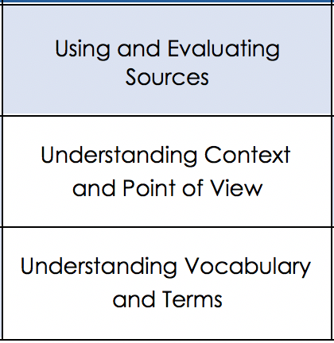
updated TEKS
primary and secondary sources
differentiate and compare
identify and ask questions about the credibility of different types of sources
identify central claim
tools to know
foundational language skills
engage in civil discourse about social studies topics
Notes:
https://lead4ward.com/docs/resources/instructional_tools/ss_revised_teks_side_by_side.pdf

Slide 5
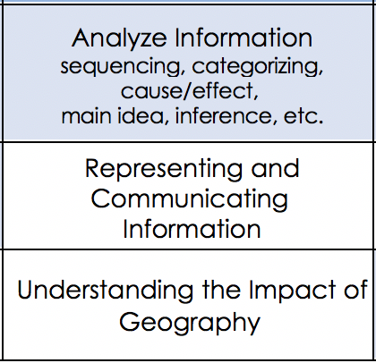
updated TEKS
use democratic procedures
simulate making decisions
develop and
communicate a claim
supported by evidence
ways to
show

Slide 6
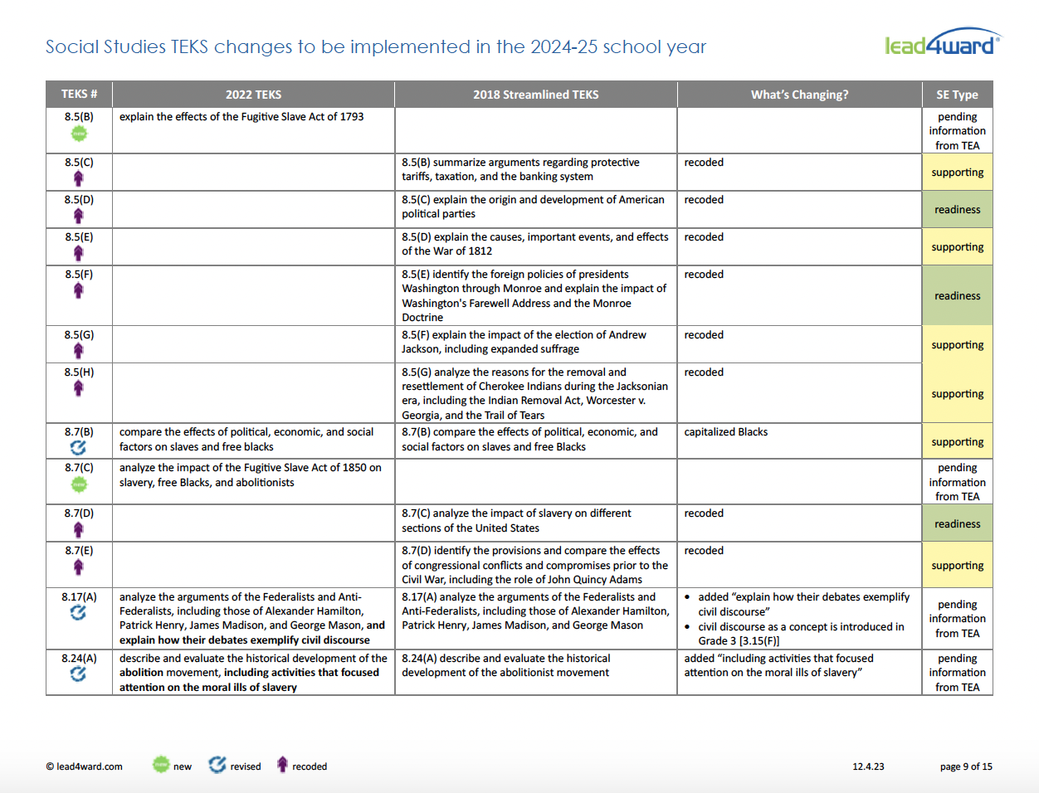
changes beyond the process TEKS
Notes:
Starting in 2nd grade-5th : use voting as a method for group decision making
8th grade- 8.5(B) 8.7(C) added
https://lead4ward.com/docs/resources/instructional_tools/ss_revised_teks_side_by_side.pdf

Slide 7
focus on
tools to
know
ways to
Show

Slide 9
assessments
interpret data inform instruction
Notes:
What types of data do we want to focus on?

Slide 10
 | 2023 % of items and points | 2023 New item type totals | 2022 v. 2023 Text based stimuli | 2022 v. 2023 Stimuli totals
8th Grade | 10/40 = 25% new item types 19/49 pts = 39% of points | Drag & Drop: 3 Hot Spot: 0 Hot Text: 1 Inline Choice: 1 Match Table Grid: 0 Multipart: 2 Multiselect: 1 SCR: 2 | 2022 7 4 primary source 3 secondary 2023 15 all primary | 2022 22 items without a stimulus 2023 12 items without a stimulus
High School USH | 14/64 = 22% new item types 28/78 pts = 36% of points | Drag & Drop: 2 Hot Spot: 2 Hot Text: 1 Inline Choice: 2 Match Table Grid: 1 Multipart: 2 Multiselect: 2 SCR: 2 | 2022 17 9 primary source 8 secondary 2023 21 12 primary source 9 secondary | 2022 19 items without a stimulus 2023 15 items without a stimulus
Notes:
Different way of looking at Frequency

Slide 11
what we see
vocabulary
stimuli
layers of thinking
Notes:
At lead4ward we got all of the content areas together and brainstormed what students needed to know and be able to do in order to be successful on staar 2.0--- these are the 3
Description of new training:
staar4ward for social studies: items to action (3-EOC) – request PD
audience: social studies teachers and leaders
(available June 2024)
What are we learning from STAAR 2.0 … and how can we use the released items to drive effective Tier 1 social studies instruction? Let’s thoughtfully analyze released items, frequency distribution, and statewide performance data to discover practical insights and identify actionable takeaways!
In this session, we’ll:
explore lessons learned from the first administration of the redesigned STAAR test
model and rehearse specific strategies that directly support the cognitive demands of the new item types, including:
unpacking and clarifying the question/prompt
making connections and layered thinking
effectively engaging with vocabulary
building fluency and flexibility with stimuli
responding to open-ended items such as short constructed response
comprehending text, primary and secondary sources, various item types, and visuals
Through engaging and structured activities, we’ll determine the implications of STAAR 2.0 and our priorities for effective social studies instruction that target growth, student thinking, and engagement!

Slide 12
A strong rationale supports the use of direct vocabulary instruction as a means to enhance academic background knowledge. Marzano Building Background
DIRECT VOCABULARY
Notes:
FILL IN THE BLANK (LIKE A STAAR 2.0 ITEM)
Direct vocab instruction is not the same thing as just integrating vocabulary.

Slide 13
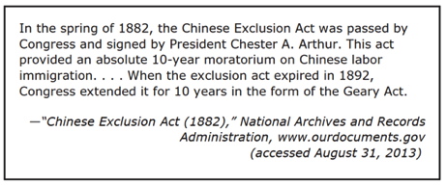
reading
primary source text
secondary source text
informational text

Slide 14
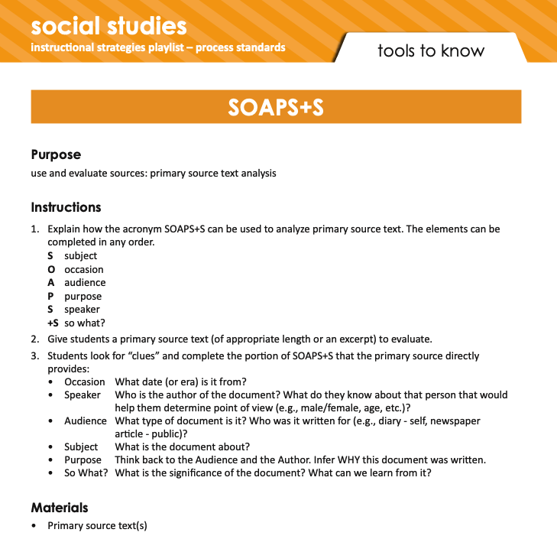
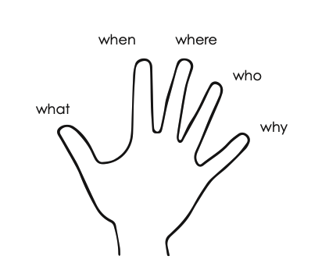
Primary Source
Informational Text

Slide 15
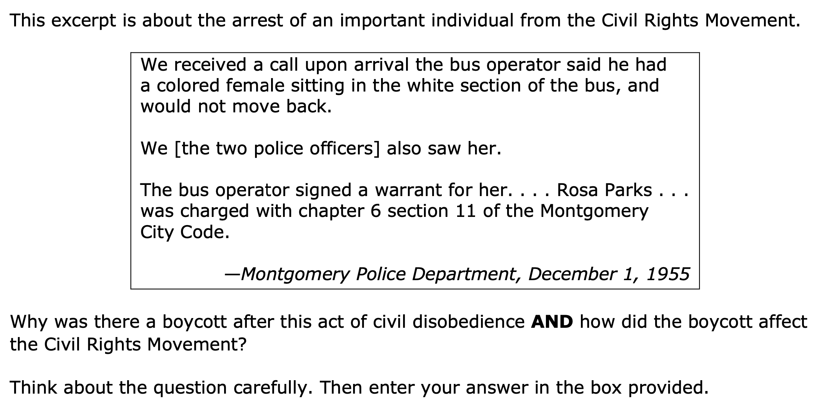
writing
Notes:
writing to develop comprehension and writing to show comprehension

Slide 16
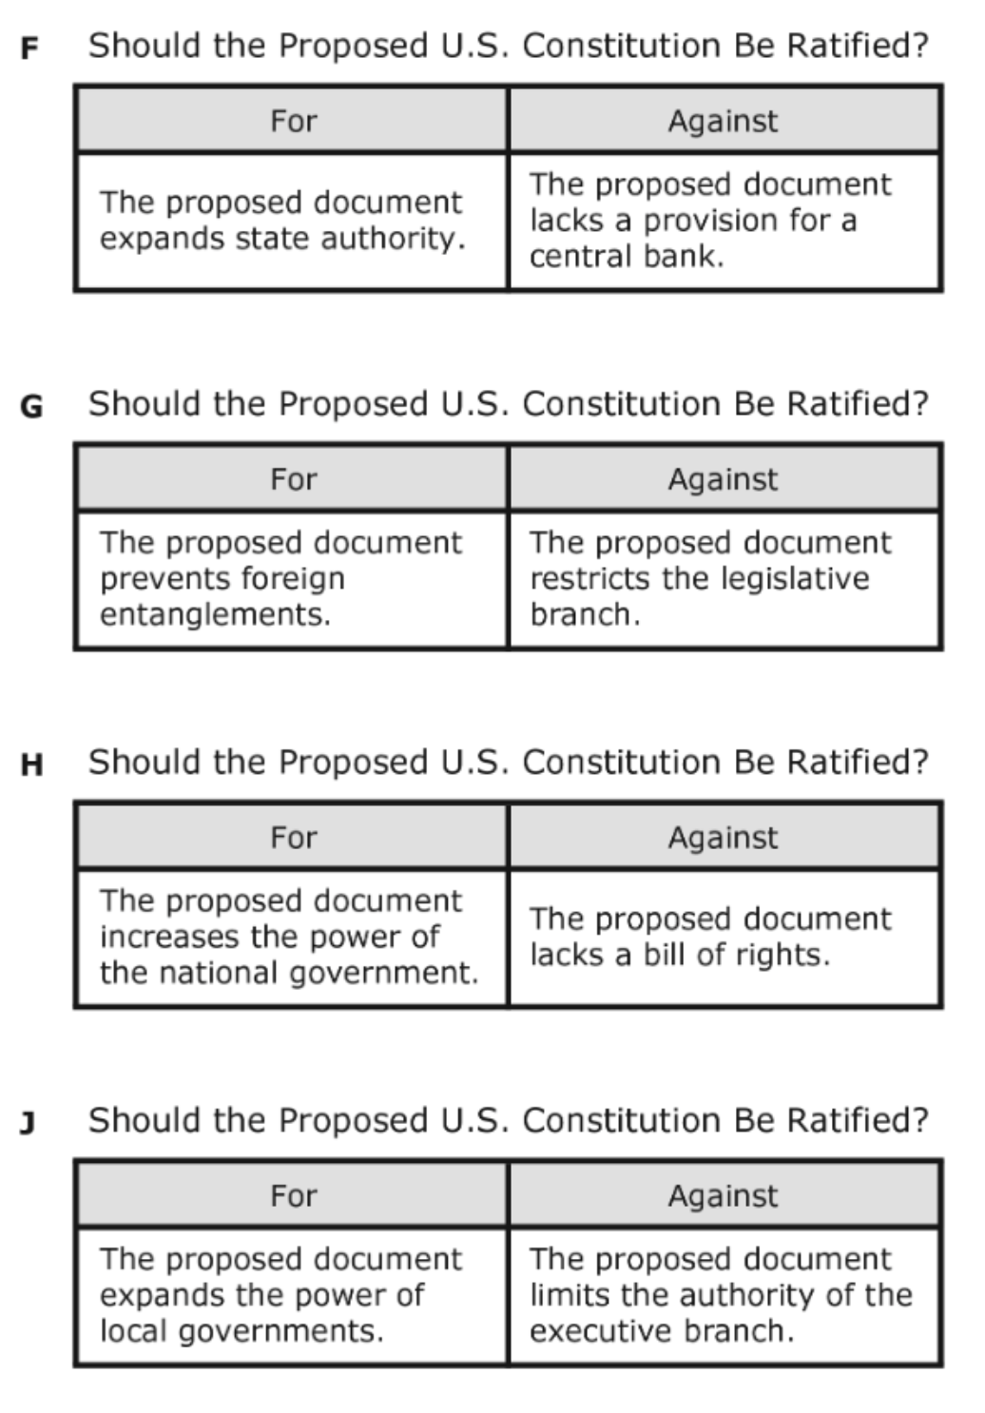
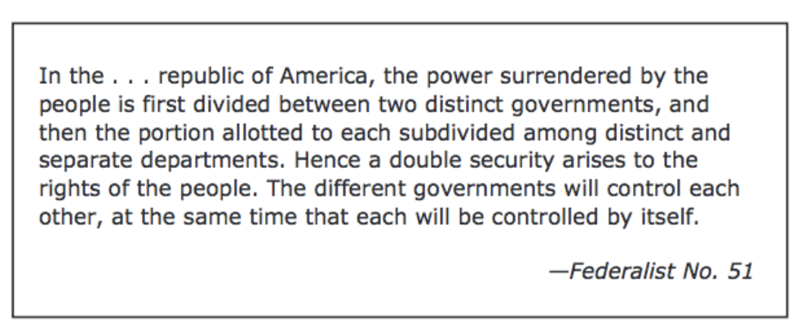
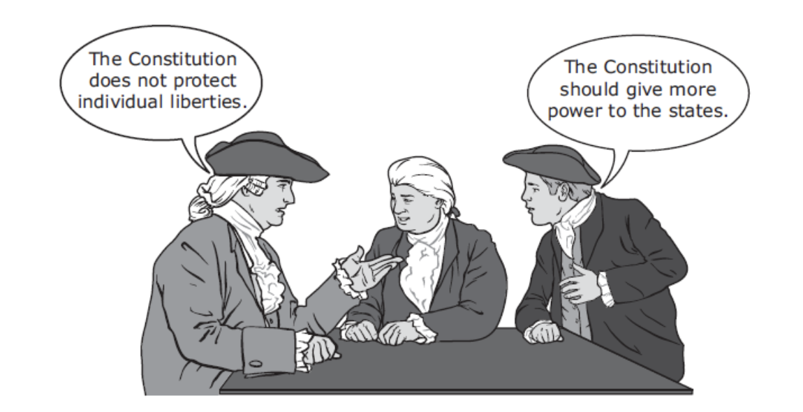
Notes:
Flexibility and fluency with stimuli and ability to peel back the layers of thinking

Slide 17
Notes:
staar4ward items to action

Slide 18
launching the year
quality tier 1 instruction

Slide 19
nurturing the new
new teachers new to grade level

Slide 20
ways to show
practice without penalty
th!nk
_________
content
engaged in learning
tools to know
quality tier 1 instruction

Slide 21
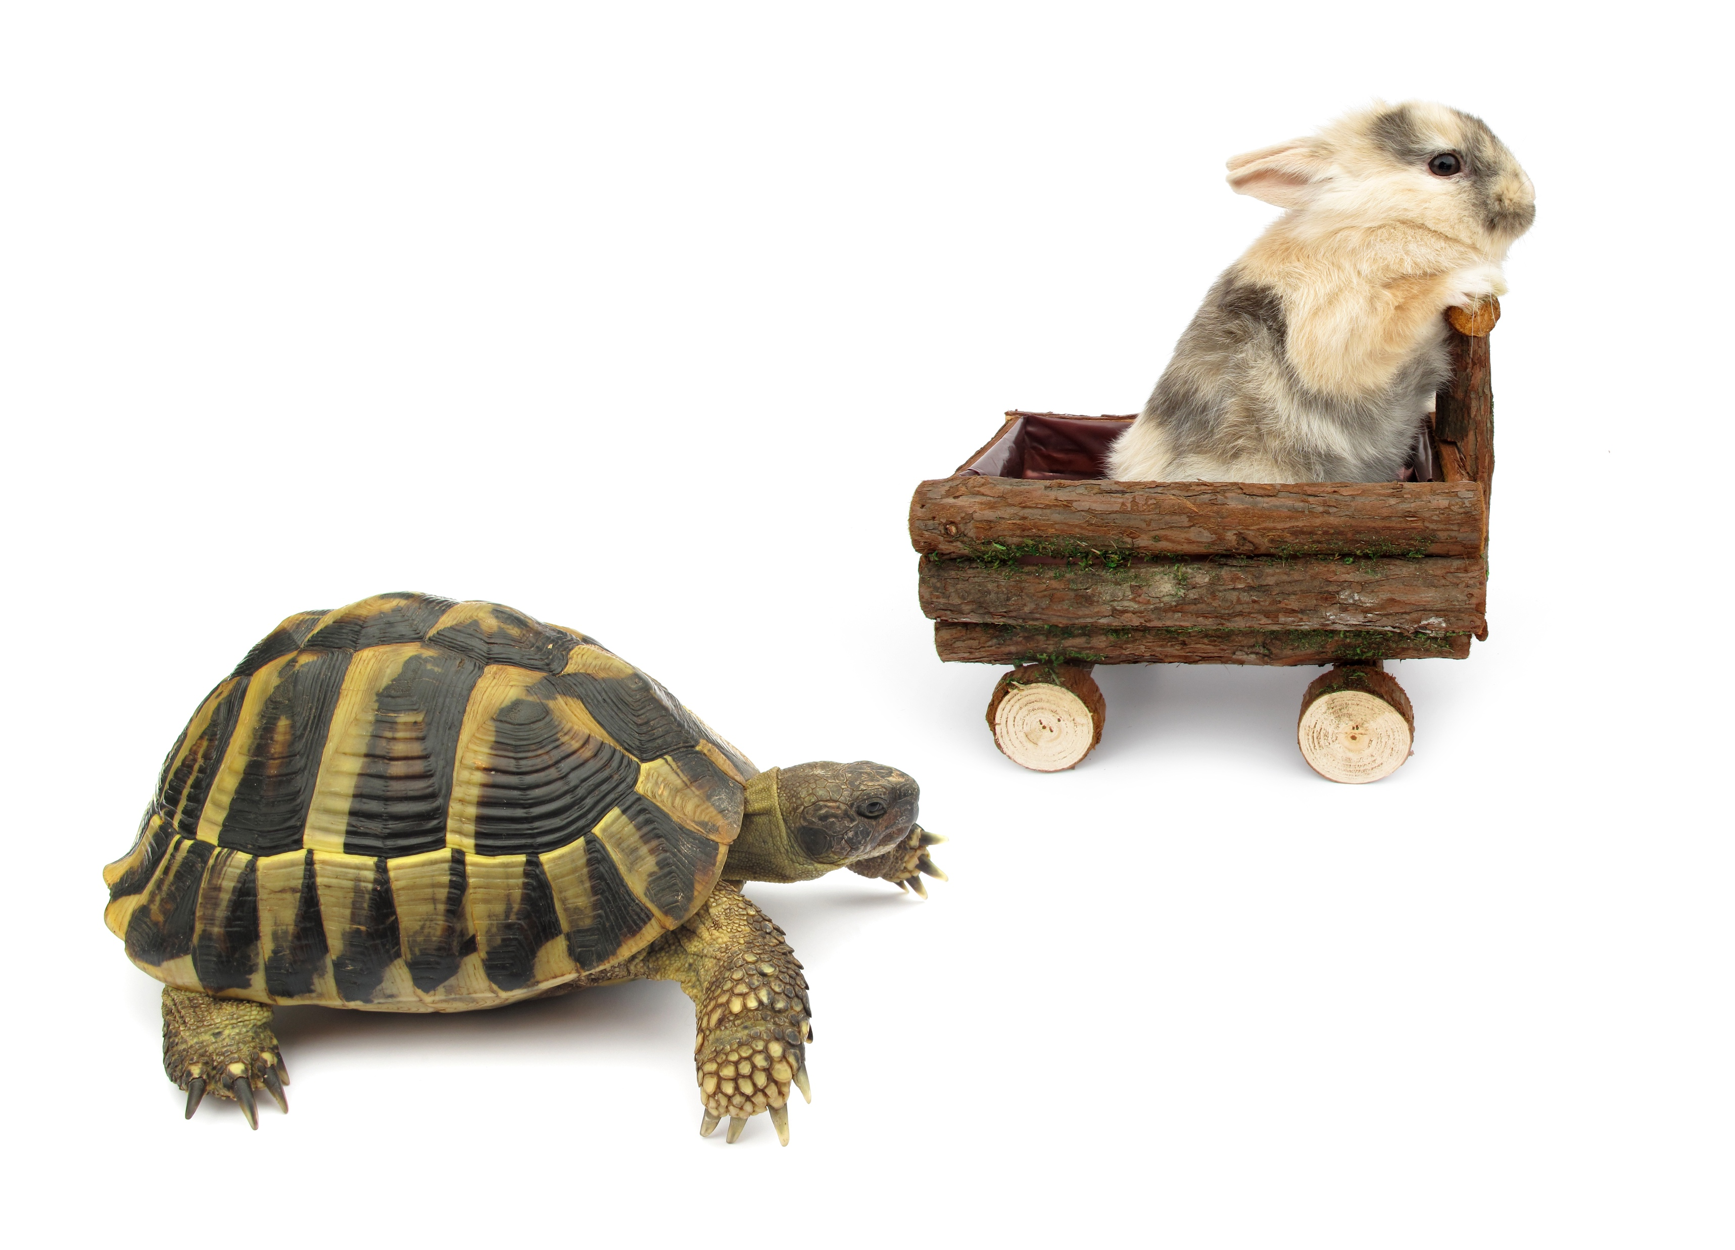
high quality instructional materials
full coverage of the TEKS
aligned to evidence-based best practices
supports all learners
embedded assessments for learning
implementation supports for teachers

Slide 22
Notes:
It is easier than it looks

Slide 24
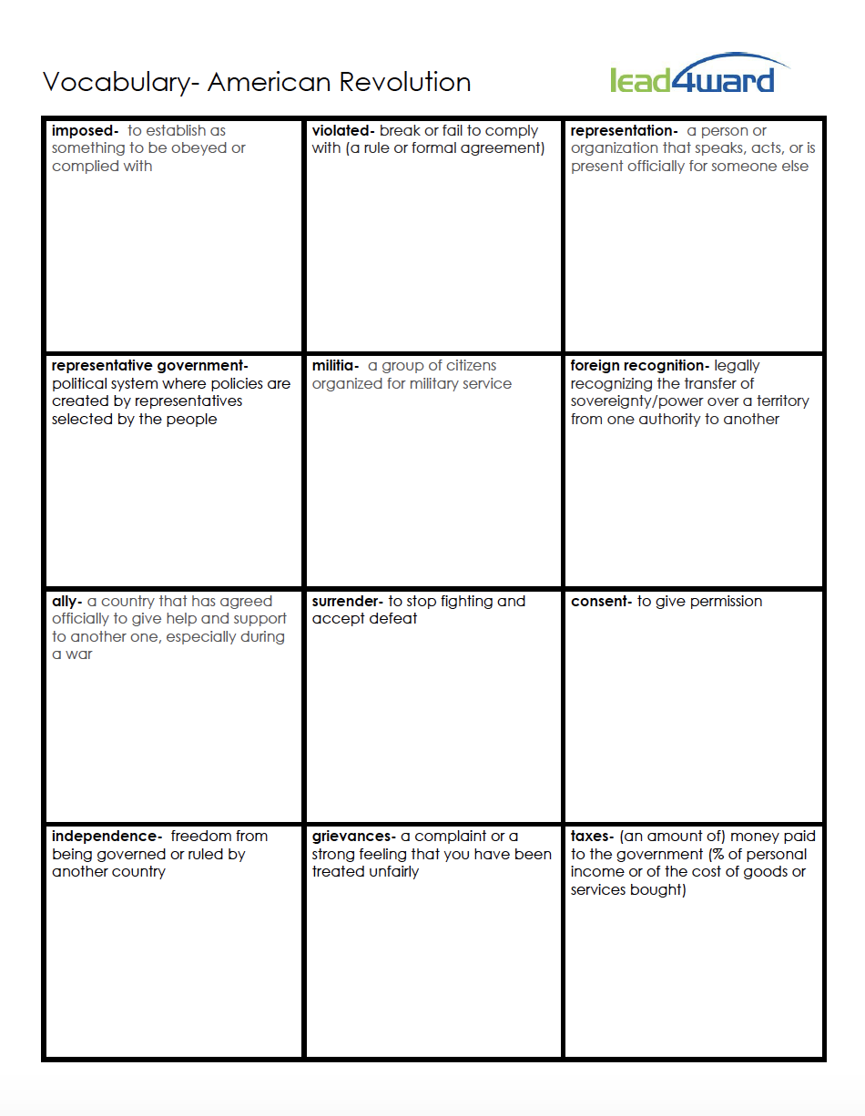
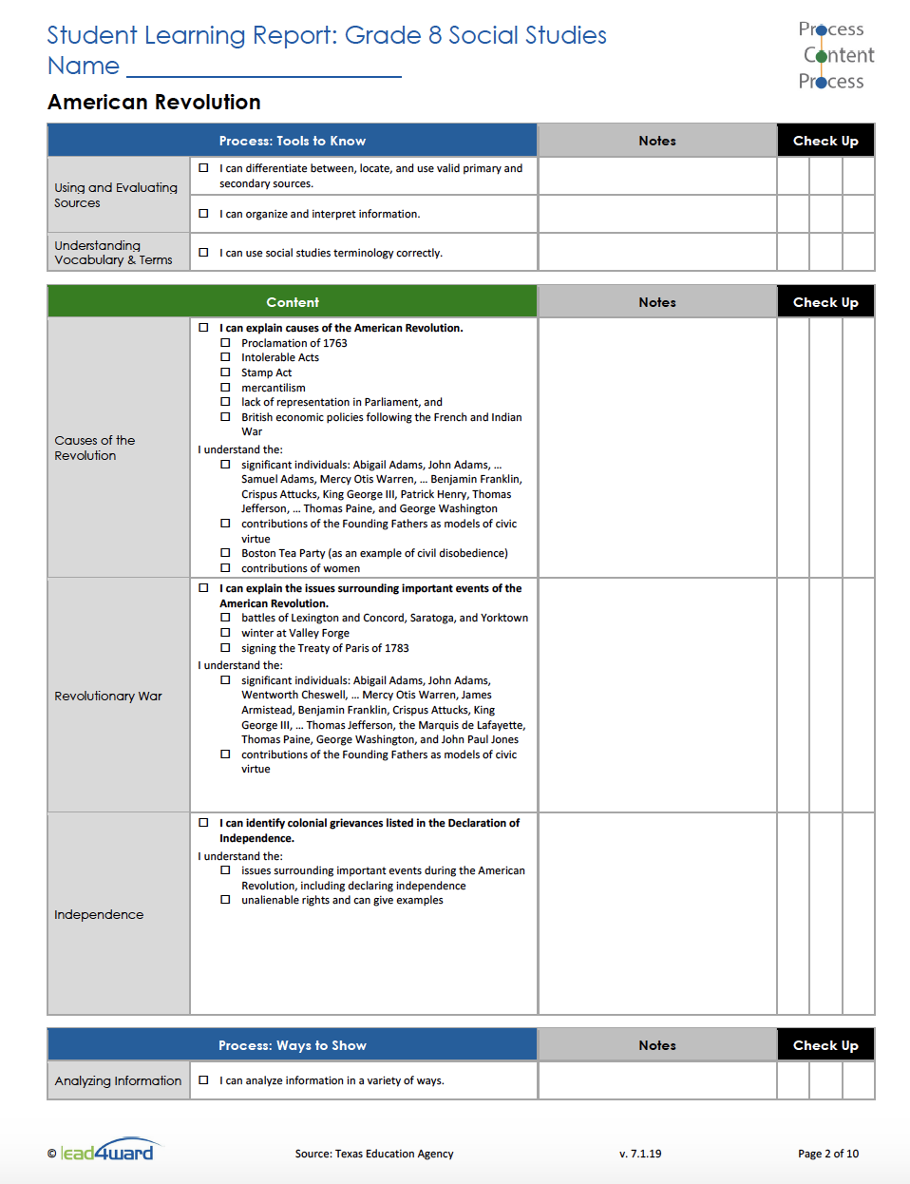

Slide 25
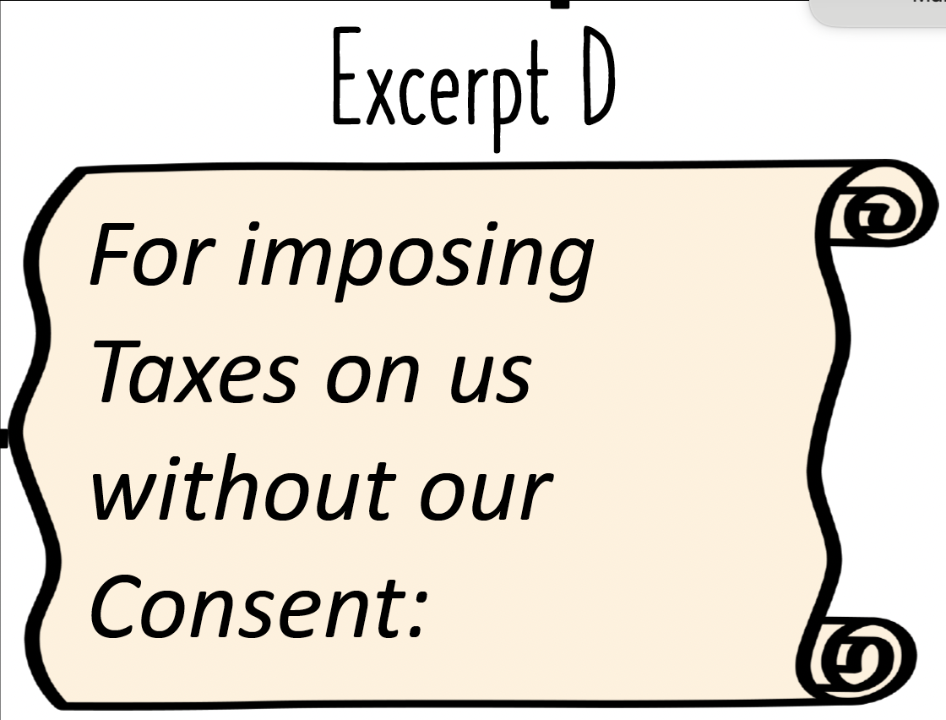
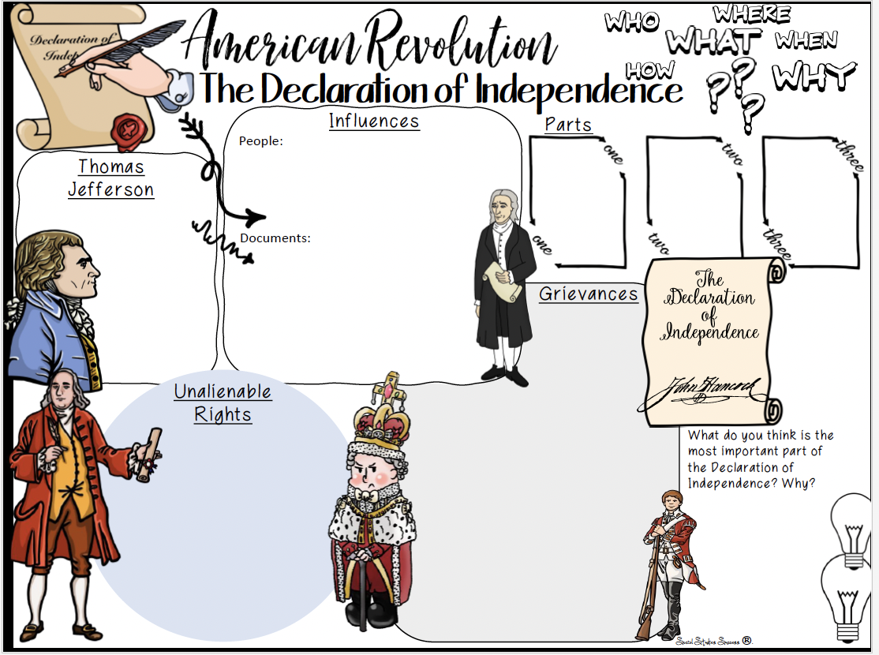

Slide 27
supporting you
jodi@lead4ward.com

